Slide 1
OBJECT-ORIENTED PROGRAMMING PROJECT PART 2 P12 (TEAM 8)
MUHAMMAD WAFIYUDDIN BIN ABDUL RAHMAN
PAE XIANG SHENG
LIM QI ZHEN
TEO WEN TIAN BRENDAN
MUHAMMAD SAAD BIN HADI

Slide 2

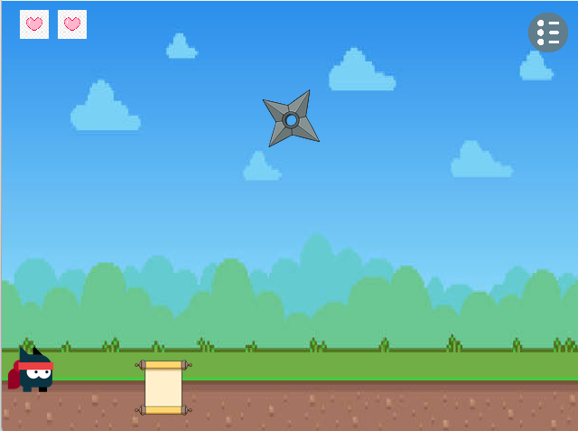
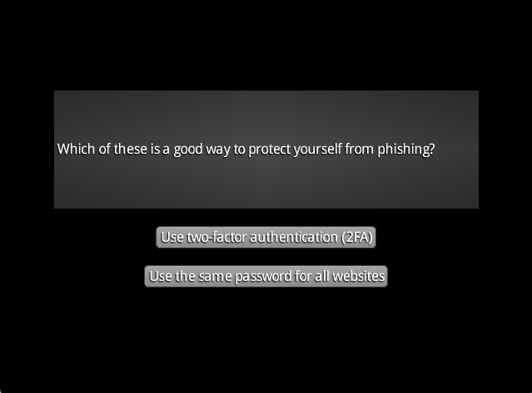
Game Implementation: Scam Prevention
Game Objective:
Raise awareness about scam prevention
Engage players through scenario-based questions on scams
Gameplay:
Players must interact with moving entities to receive scam-related scenario questions
Features for Enhanced Fun and Challenge:
Moving obstacles
Randomised power-up and obstacle placements
Varying power-up spawn rates
Notes:
Our game aims to raise awareness about scam prevention by engaging players in scenario-based questions related to scams. Players interact with moving entities to obtain these questions, creating an educational experience while having fun. To make the game more exciting and challenging, we’ve incorporated moving obstacles, random placements of power-ups and obstacles, and varying spawn rates for power-ups. These features add an extra layer of difficulty and excitement, ensuring the game stays engaging and dynamic throughout

Slide 3
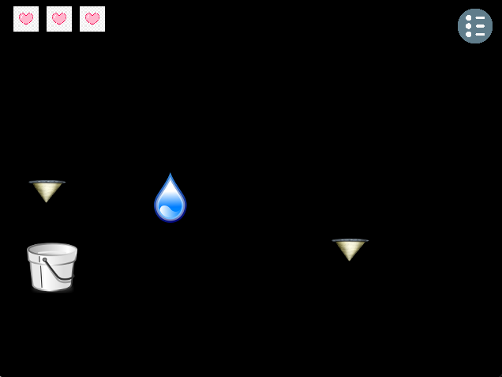

Game Engine - Key aspects
Design:
2D game with side camera view
Flexible key binding for keyboard input
Scalability:
Flexible and scalable collision management for interactive entities.
Reusability:
Addition of entities and scenes in game engine
Notes:
Our game engine is designed with a 2D side camera view, providing a clear perspective for gameplay. It also features flexible key bindings for keyboard input, allowing players to customize controls for a better experience. In terms of scalability, the engine supports flexible and scalable collision management for interactive entities, ensuring smooth gameplay as the game grows. For reusability, the engine allows for the easy addition of new entities and scenes, making it adaptable for future expansions and updates.

Slide 4
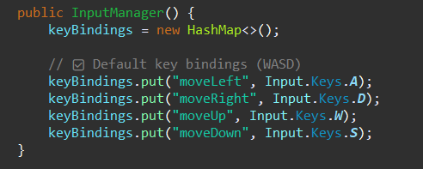
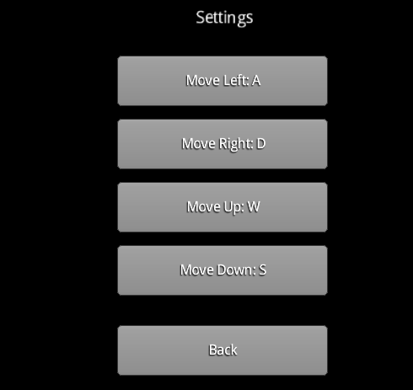
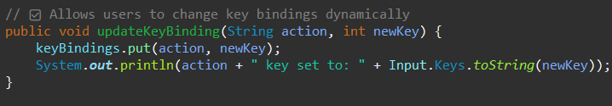
Game Engine - Key Improvements (Input)
Purpose:
Assign specific keys to actions (Previously only handles Up and Down, but after implementing the game, the Input Manager have improve to add Up, Down, Left and Right for flexibility.)
Able to dynamically update keys based on user input via the updateKeyBinding method.
Code examples for InputManager class:
Able enable a flexible keybinding based on user preferences in which it will be flexible for many games implementations.
Used by the Movement Manager and Settings Screen

Slide 5
Game Engine - Key Improvements (Audio)
Purpose: Handle background music and sound effect
Changes:
Playing of audio
By filePath
Interaction with ObstacleCollisionHandler

Slide 6
Design Pattern: Singleton
AudioManager (Singleton):
getInstance() method
Relation with SceneManager by Dependency injection
Benefits:
Reduce redundancy
Eliminate circular dependency

Slide 7
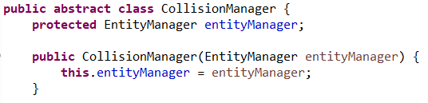

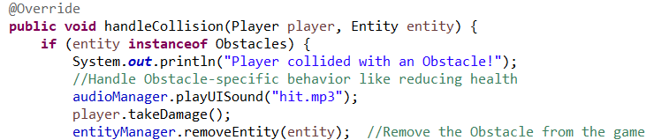
Game Engine - Key improvements(Collision)
The application specific logic has been removed from the original collision manager, and it now has been made abstract to improve flexibility and reusability. In addition, a new shared CollisionHandler interface is created.
Instead of a single collision manager, there are now separate collision handlers for each game object type. Powerup, Obstacle, and Diamond implements the CollisionHandler interface, and within each handler, defines specific actions for collisions with those objects.
Example(ObstacleCollisionHandler):

Slide 8
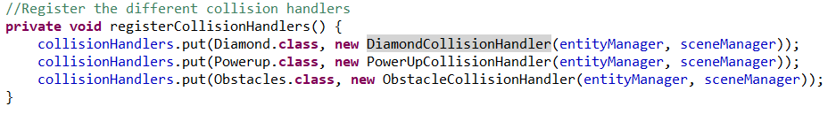

Game Engine - Key improvements(Collision)
To manage these collision handlers, a new dedicated collision manager that extends the abstract original collision manager, called PlayerObjectCollisionManager. This manager registers the several different collision handlers for specific game objects in a hashmap, using the class of the object being collided as the key.
When collisions are detected in the game, this manager calls upon the specific handler and calls the handleCollision method specified in its own collision handler, depending on what the Player collided with.

Slide 9

Design Pattern: Strategy Pattern
Strategy interface:
The class collisionHandler specifies a handleCollision() method that must be implemented by the handlers.
Collision Handlers(Strategies):
Different handlers for specific game objects (e.g., Diamond, PowerUp, Obstacle)
Each handler implements a handleCollision() method to manage specific collisions.
PlayerObjectCollisionManager(Context):
Acts as the context class,manages and applies the appropriate collision handler based on the object involved.
Benefits:
Flexible: Easily swap collision strategies based on the object type.
Maintainable and scalable: Each strategy is isolated in its own handler, which makes the code easier to manage and extend if there are new object types.

Slide 10
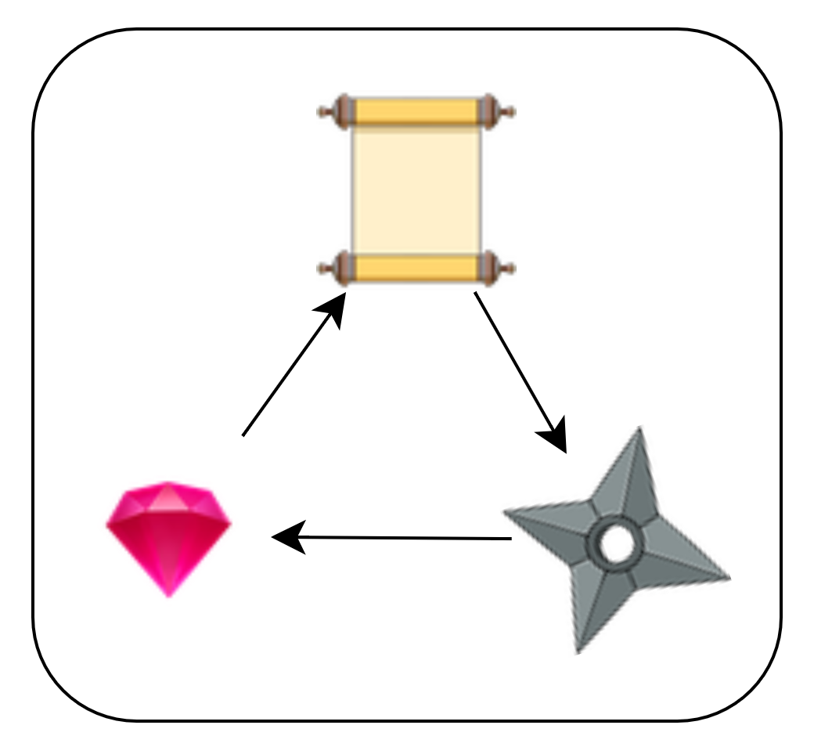
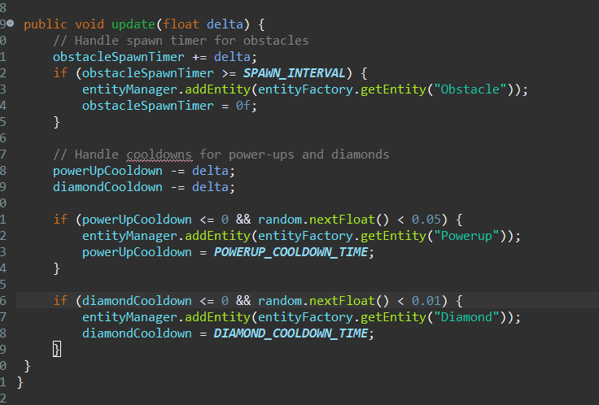
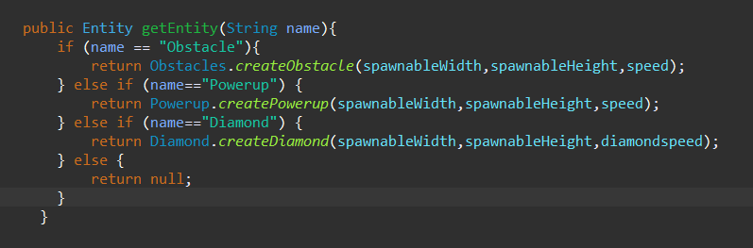
Design Pattern: Factory Method
In SpawningManager.java:
In EntityFactory.java:
In GameScreen.java:
Benefits:
Maintainability: Centralised point of control for object spawning
Scalability: factory class can be modified to add more entities

Slide 11
Summary of Report
Overall Game Design:
Modular architecture
Scalable and maintainable
Uses OOP and SOLID principles
Educational + interactive gameplay
Design Pattern Implementations
Factory (for entity spawning)
Strategy (for collision handling)
Singleton (for AudioManager)
Limitations with Game Engine and Layer
No in-game audio controls (mute, volume, track change)
No dynamic difficulty adjustment for pacing
Input system doesn’t yet support gamepad/controller
Input
Collision
Audio
UI
Game Core

Slide 12
Game Demonstration

